Slide 1
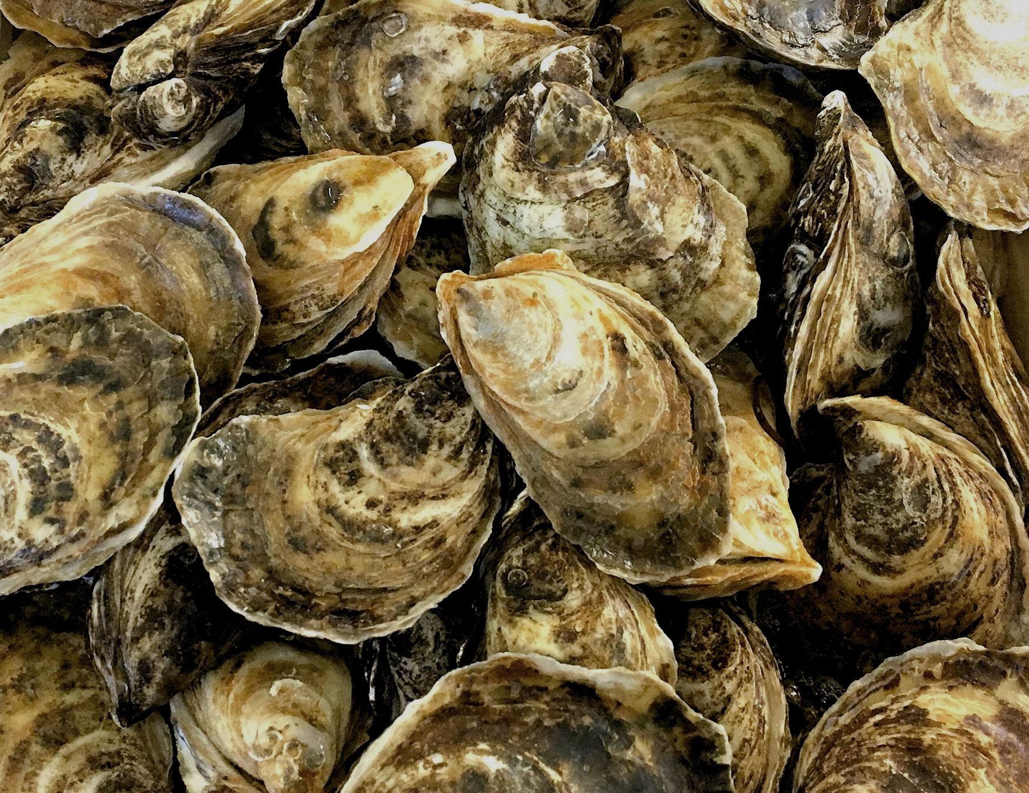
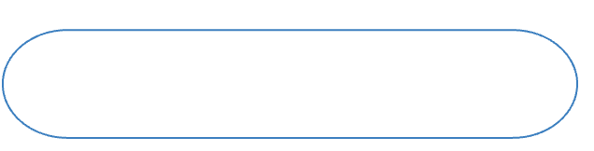
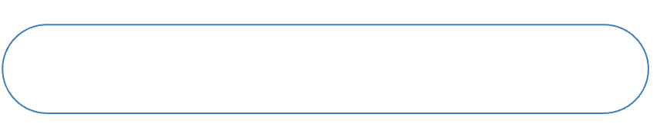

NOVEMBER 2025
Oyster MSX
Pipeline
A Human-in-the-Loop System for Accelerating MSX Diagnosis in Oyster Histology
BY JONATHAN E. ZUL LUNA
Mentors:
Dr. Kristina Kupferschmidt, Dr. Andrew Godbout, Dr. David Groman
Notes:
Good morning. My name is Jonathan Zul Luna, and I'm a 4th year Computer Science student at UPEI.
[Pause. Gesture to the image of oysters on the slide.]
These are Eastern oysters. And for Prince Edward Island, they're much more than just seafood—they're an essential part of our economy and coastal identity.
However, this industry is facing a serious threat from a microscopic parasite that causes a disease called MSX.
Today, I will talk about my summer research and current Honours project, where I'm focusing on finding a way to help experts diagnose this disease much, much faster.
[Click to next slide]

Slide 2
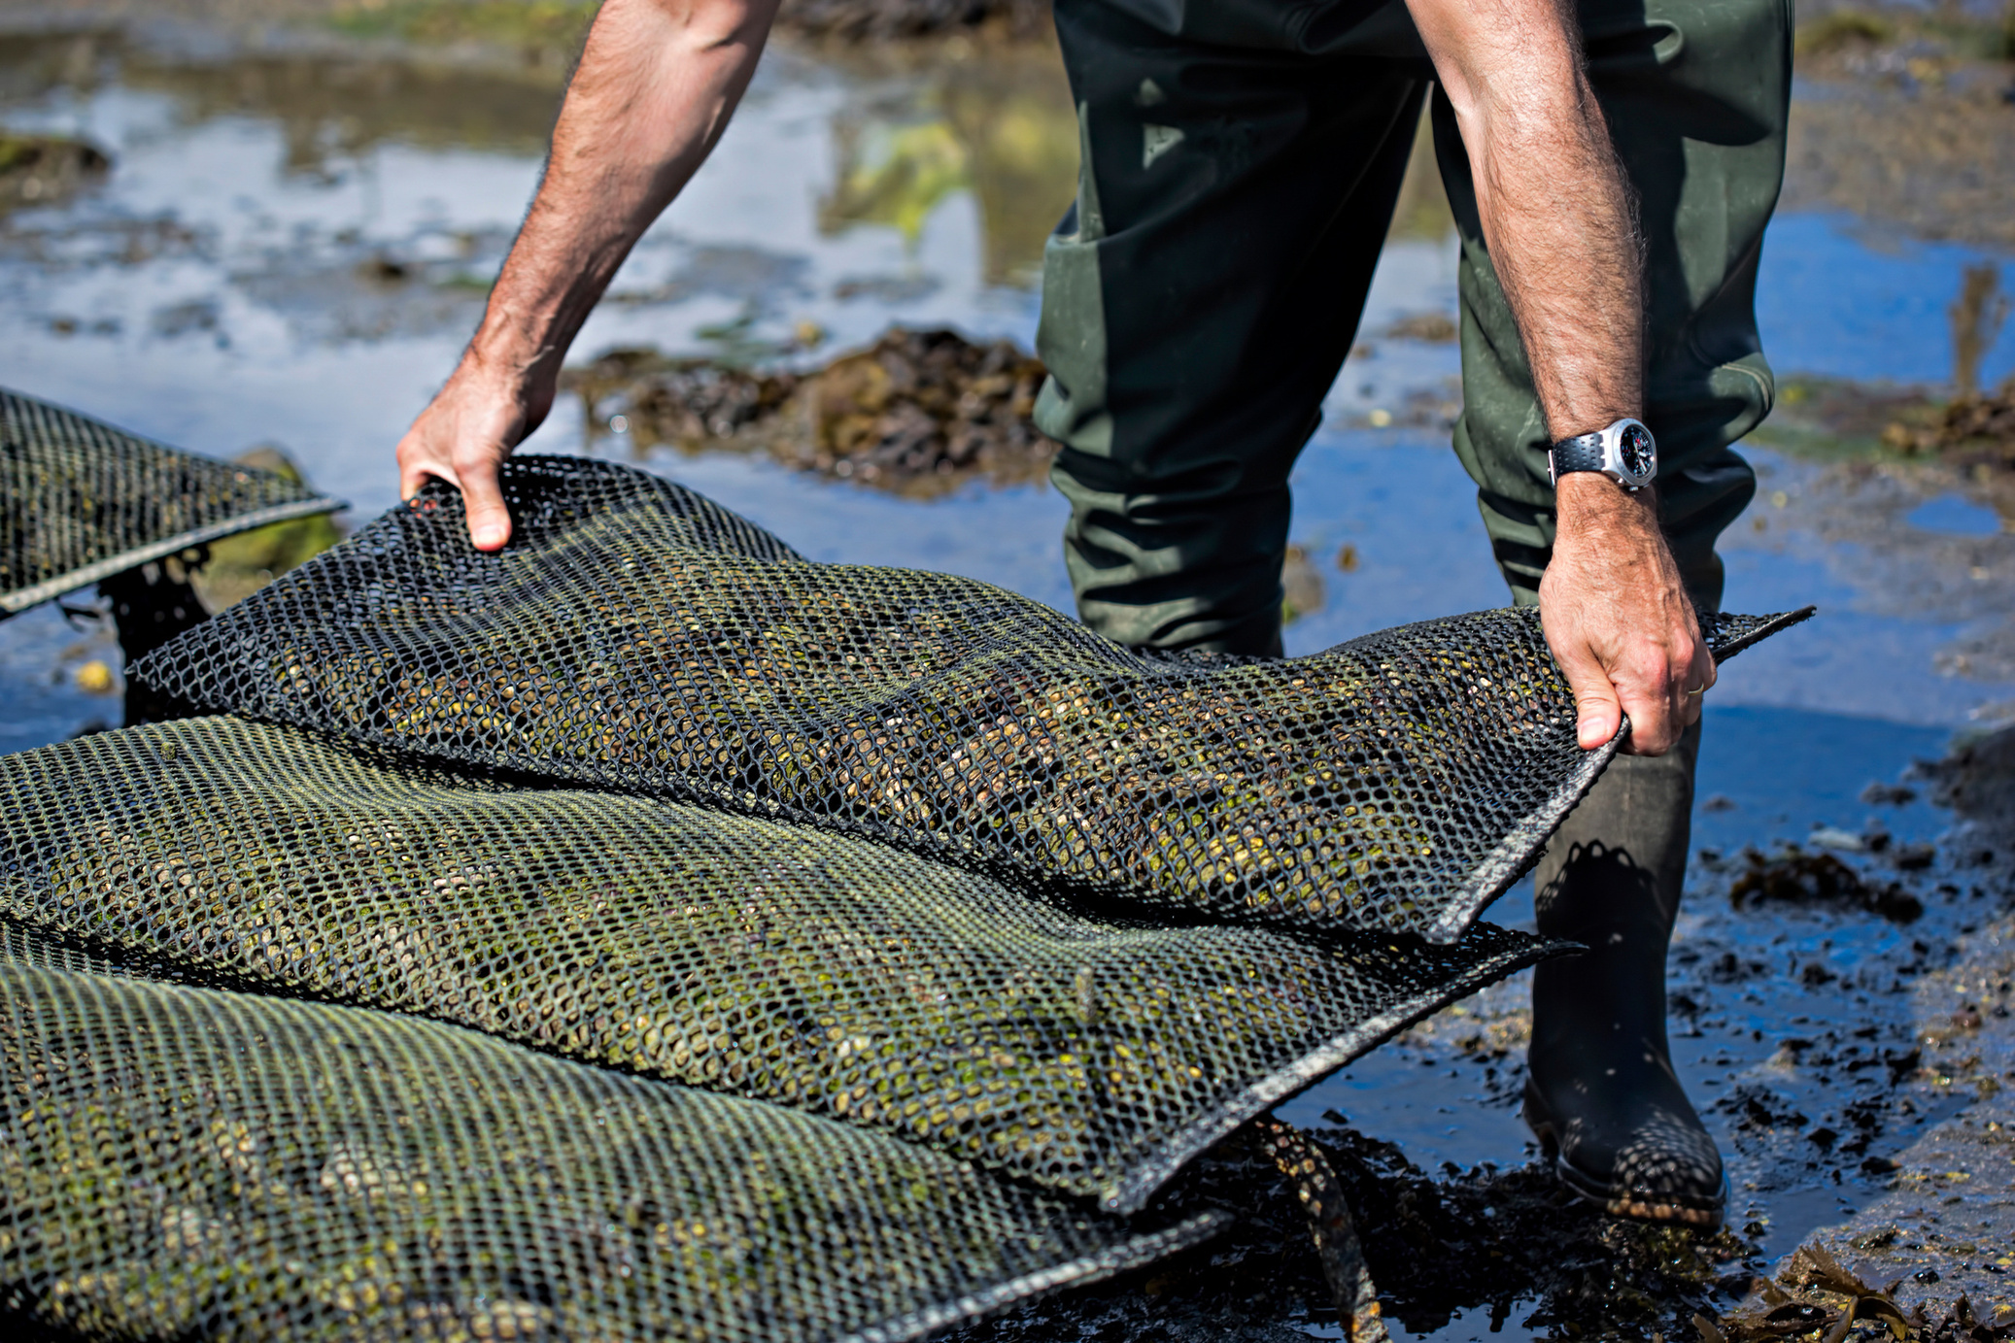
The Economic Engine
PEI’s Oyster Aquaculture Industry
A Key economic driver for the province, valued at over $24 million annually.
Supports hundreds of jobs in rural and coastal communities.
Notes:
But before we talk about the technology, I want to start by talking about why this work is so important for our region.
As I mentioned, in PEI, the oyster industry is woven into our identity.
[Click to show the first bullet point]
Financially speaking, it is a huge economic engine for the province, bringing in over 24 million dollars every year.
[Click to show the second bullet, Gesture to image]
Additionally, it supports hundreds of jobs in the rural and coastal communities that define the island.
[Pause for effect]
So, we have this very important industry... but, as we know, it faces a serious, persistent threat.
[Click to next slide]

Slide 3
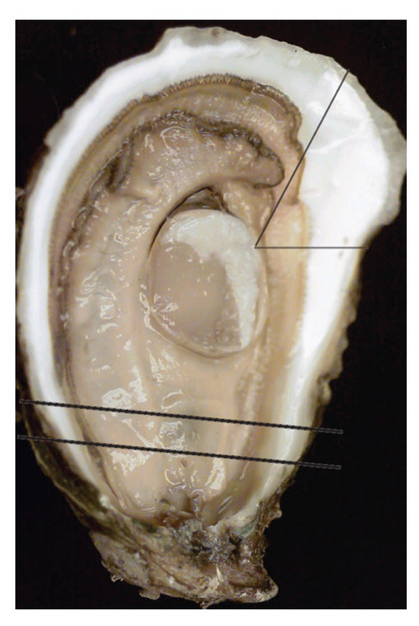
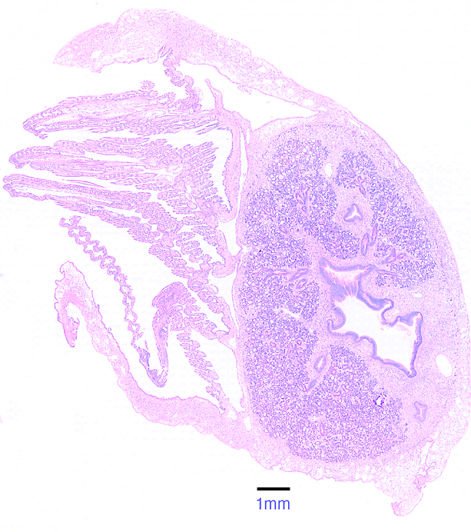

From Oyster to Image
Creating the Histology Slide
A thin cross-section of the entire oyster is processed and stained to make cellular structures visible under a microscope.
Notes:
That threat is microscopic. So, to find an enemy that small, you can't just look at an oyster on the half-shell—you have to look inside the tissue itself. The tool that allows us to do that is called a histology slide.
Here you can see exactly how we get from a whole oyster to the digital image that we analyze.
On the left, you can see a standard oyster. The yellow band highlights a very specific location where a thin cross-section of the entire body is carefully cut.
After a multi-day process of preservation, staining, and scanning, that single, thin slice of tissue becomes the high-resolution image you see on the right. This is what we call a Whole Slide Image.
Now that we understand what a histology slide is, let's take a look at some examples to see the threat we're trying to find.
[Click to next slide]

Slide 4
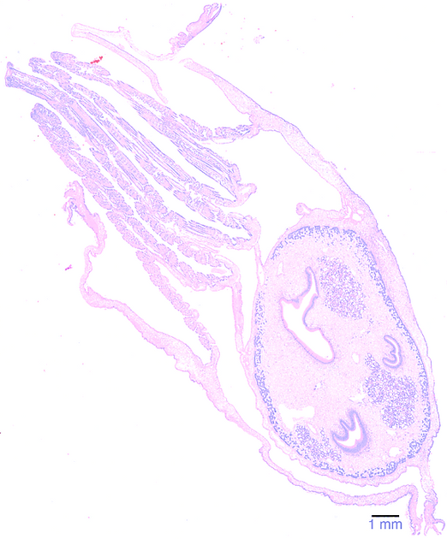
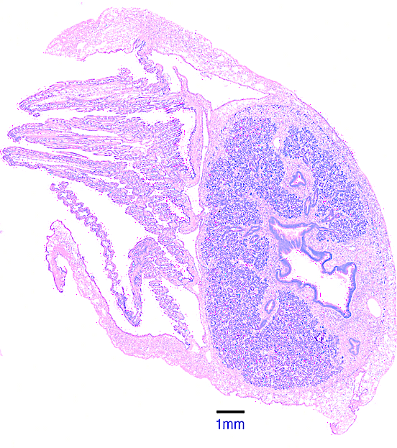
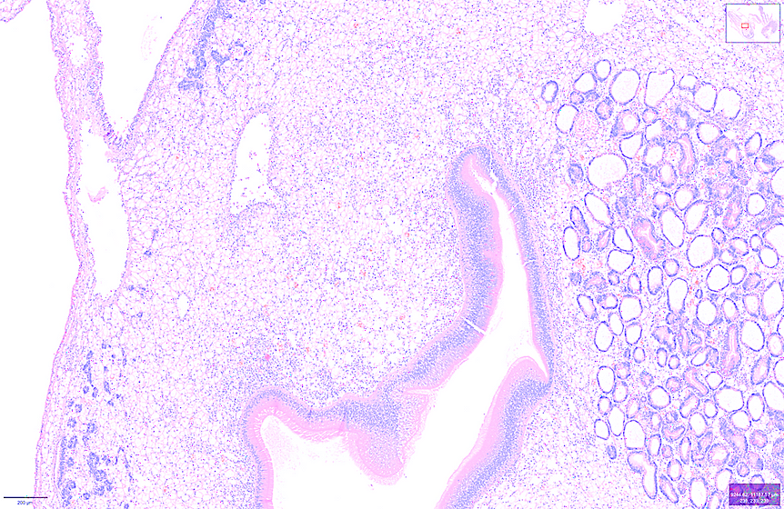
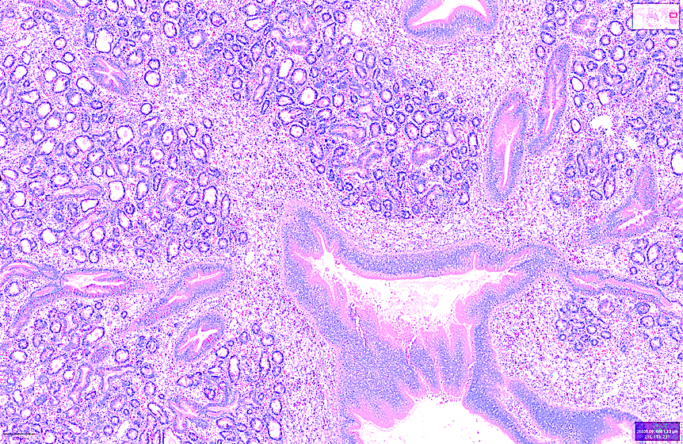
A Microscopic Threat
The MSX Parasite (Haplosporidium Nelsoni)
A protozoan parasite that causes Multinucleated Sphere X (MSX) disease.
Leads to severe tissue damage and high mortality rates in infected oysters.
Early and accurate detection is the only way to manage its spread and protect the industry.
Healthy Oyster Tissue
MSX-Infected Tissue
Notes:
That threat is a parasite called Haplosporidium nelsoni, which causes MSX disease.
The best way to understand the damage it does is simply to see it.
[Click to show healthy oyster]
Here, we have tissue from a healthy oyster. Notice how clean and structured it looks.
[Click to show infected oyster]
Now, look at this tissue on the right.
[Wait 3 seconds]
This is from an oyster with an advanced MSX infection. You can see the difference even if you're not an expert. The infected tissue looks more chaotic, it has a stronger purple color, and the normal structure is breaking down.
That is the result from the parasite literally destroying the oyster from the inside.
But let's now look at it closer to see what is going on more in detail.
[Click to take images out]
[Click to next slide]
‹#›

Slide 5
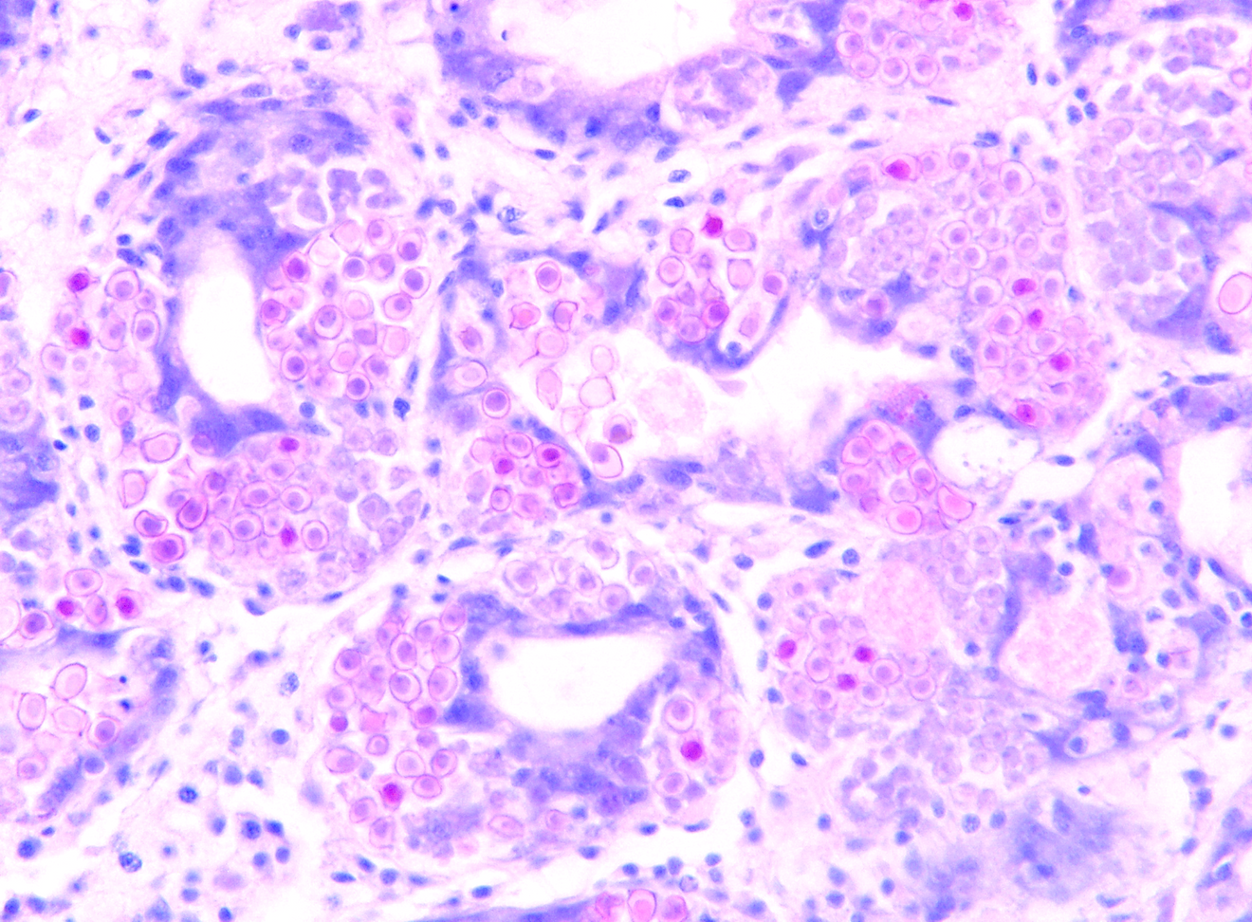
A Microscopic Threat
The MSX Parasite (Haplosporidium Nelsoni)
A protozoan parasite that causes Multinucleated Sphere X (MSX) disease.
Leads to severe tissue damage and high mortality rates in infected oysters.
Early and accurate detection is the only way to manage its spread and protect the industry.
A high-magnification view showing multiple sporocyst clusters (arrows) of the MSX parasite, surrounded by the oyster's intense inflammatory response.
Notes:
At this magnification, we can see the direct impacts.
The arrows point to the parasite in its "spore-releasing" stage.
But do you see all those small, dark purple dots?
That's the oyster's immune system swarming the area. That's what was causing that purple color in the previous slide. This is an intense inflammation response aiming to destroy the parasite. However, it destroys the oyster tissue in the process, killing the oyster instead.
And since there's no cure, our only defense is early and accurate detection before the disease spreads to other oysters.
So, how do we detect it?
[Click to next slide]

Slide 6
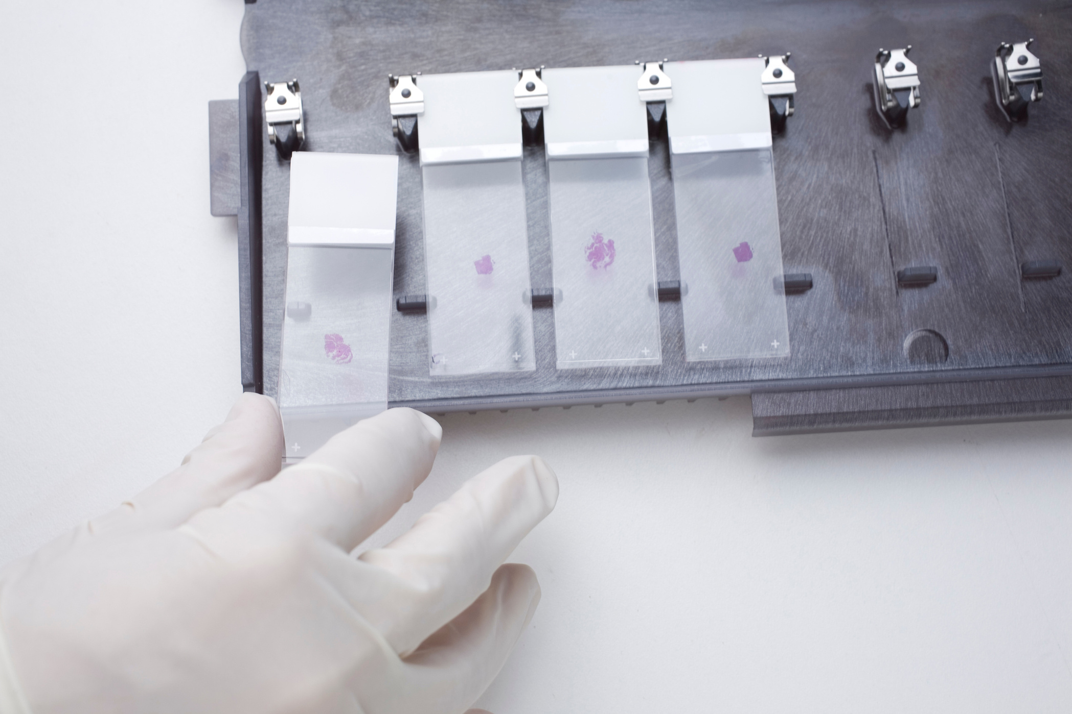
The Diagnostic Front Line
The Role of the Atlantic Veterinary College (AVC)
The AVC is the primary centre for histology-based diagnosis in Atlantic Canada.
Histology is the gold standard for assessing disease severity, unlike other methods (e.g., PCR).
Diagnosis relies on manual slide review by a small number of trained pathologists.
This process is time-consuming, costly, and creates a significant workflow bottleneck.
Notes:
That's all done at the Atlantic Veterinary College, or AVC.
[Click to show first point]
They're the main histology-based diagnosis center in Atlantic Canada.
[Click to show second point]
There are other diagnosis methods like PCR, which can detect a parasite's DNA. That's great for a simple 'yes' or 'no' answer. But to understand the severity of an infection, you need histology.
[Click to show third point]
That means we need a trained expert look at the tissue under a microscope.
[Click to show fourth point]
The challenge is that this process is entirely manual, and it relies on a very small number of pathologists.
This entire process is slow and expensive, and because there's only a handful of experts, it's a huge bottleneck.
In our case, the AVC has a single pathologist, Dr. David Groman, looking at thousands of slides for the entire Atlantic Canada region. He mentioned he has received over 6,000 samples just in the period from April until today. It would take a really long time for him to get through all those slides.
So that's why we are helping build a custom tool to assist in this process.
[Click to next slide]

Slide 7




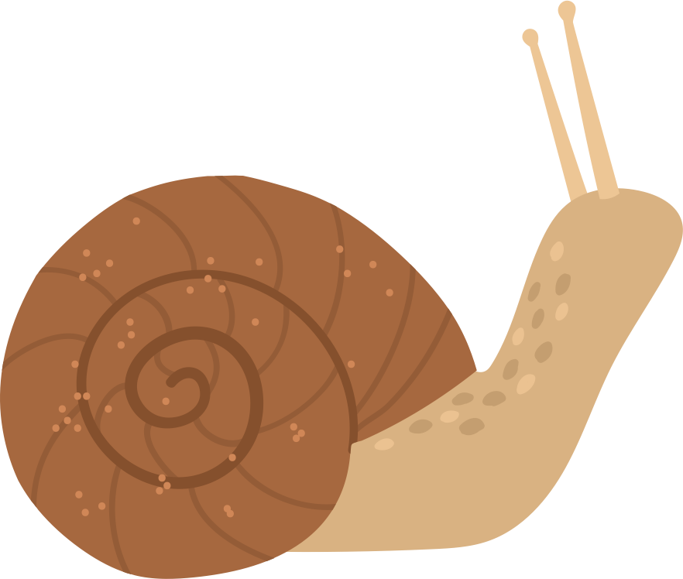
The Data Challenge
Building a High-Quality Dataset from Scratch
The Paradox: To build a tool that saves expert time, we first need a large investment of that same limited expert time.
Notes:
The first step for every ML project is to analyze our data.
[Click to show No Data graphic]
However, in our case, it didn't exist. There are no publicly available MSX datasets.
[Click to show Expert graphic]
We had to create our own 'ground truth' by asking those same busy pathologists to spend hundreds of hours manually outlining parasites slide after slide.
This created a paradox: to build a tool that saves expert time, we first need to use a lot of their time.
So, we focused on breaking that cycle.
[Click to next slide]
‹#›

Slide 8
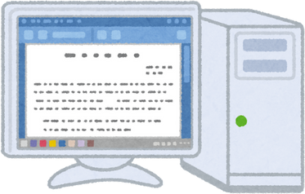
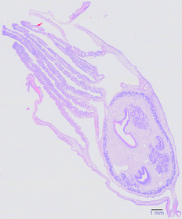




Stage 1:
AI Pre-Analysis
The Strategy
A Human-in-the-Loop Workflow for Pathology
The pipeline performs a first-pass analysis, generating initial annotations on a new slide.
Stage 3:
Model Retraining
Stage 2:
Expert Review
The validated annotations are used to improve the AI model, making it smarter with each cycle.
A pathologist quickly validates and corrects the AI's suggestions, saving valuable time.
Notes:
Our approach is a strategy called Human-in-the-Loop.
Instead of building an AI in isolation, we create a 'virtuous cycle' between the expert and the machine.
[Click to show Step 1 graphic]
First, our automated pipeline performs a pre-analysis on a new slide, generating a set of initial annotations and flagging potential areas of interest.
[Click to show Step 2 graphic]
Next, these suggestions are sent for expert review. This saves a lot of time because instead of searching a massive, blank slide, the pathologist can just validate and make small corrections to the AI's guesses.
[Click to show Step 3 graphic]
And lastly, their corrections are used to retrain the model. So, with every slide we process, the AI gets smarter.
[Click to next slide]

Slide 9
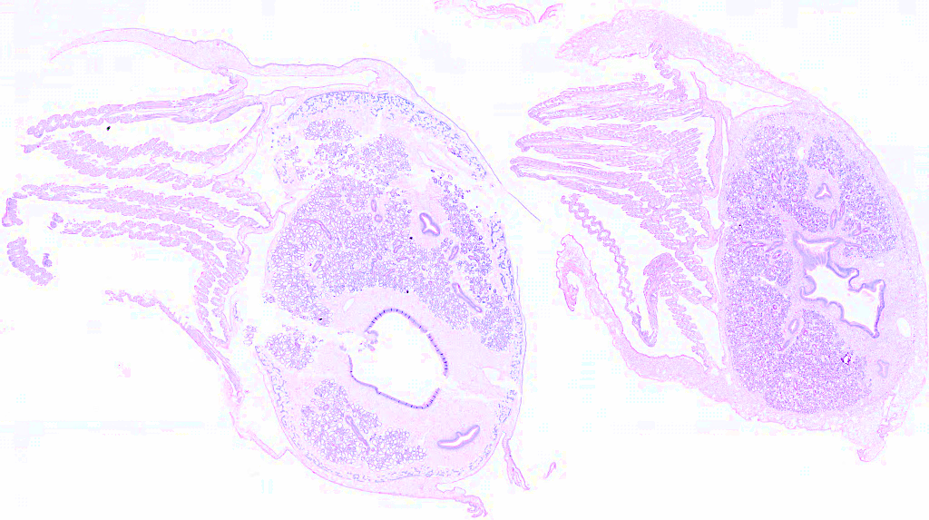
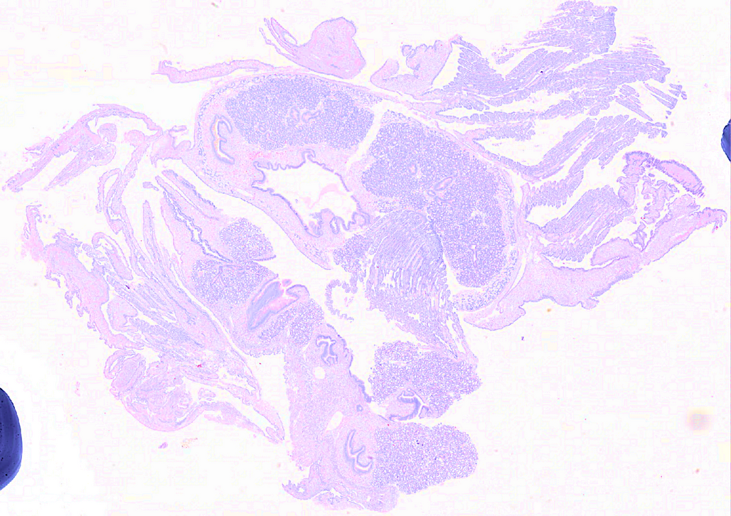
The First Hurdle
Challenge: How can we create a single, automated process that works reliably for both of these cases without manual intervention?
Robustly Separating Oyster Sections
The Ideal Case
The Common Reality
?
?
?
1
?
?
2
Notes:
So, to make that Human-in-the-Loop strategy a reality, I created a complete, automated pipeline. However, we found a challenge along the way.
Before we can even look for a parasite, we have to solve a much more basic problem: figuring out which tissue belongs to which oyster.
Now, you are probably wondering what I mean by this. Well, most of the oyster slides available at the AVC contain more than a single oyster. This cuts costs and improves efficiency. However, this is what creates our challenge.
[Click to show Ideal Case image]
Sometimes, you get a perfect slide like this. The sections are well-defined and clean. Writing code to handle this is easy.
[Click to show Common Reality image]
But the reality is usually much messier. Because the slides are prepared by hand, as we saw previously, we often get tissues that are fragmented, overlapping, or touching. A simple approach that works for the ideal case will fail completely here.
We need a robust approach that can outline each oyster separately, performing well even in tough cases.
[Click to next slide]
‹#›

Slide 10




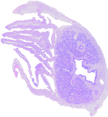


Finding the Right Technology
A Comparison of AI Approaches
Rigorous Testing
Notes:
Now, the first automated step in our Human-in-the-Loop system is solving the segmentation challenge—teaching the computer how to accurately find the oysters on the slide.
To find the best technology for this job, we didn't just pick one method. We tested many different AI approaches to see which would be the most accurate and reliable.
But to compare them, we first needed a clear way to measure success.
[Click to show Dice Score]

Slide 11


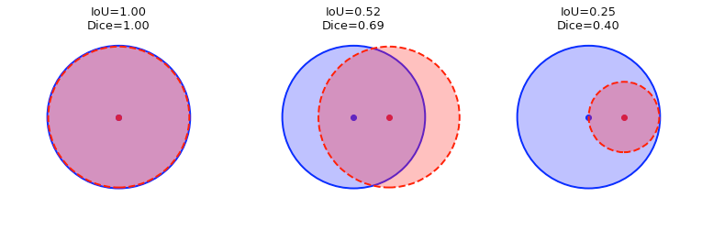




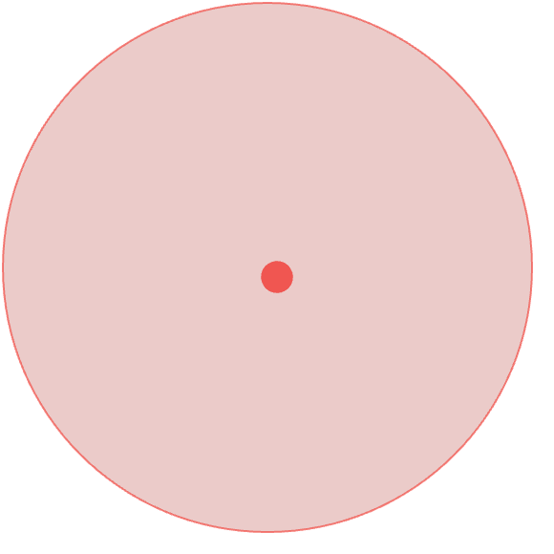
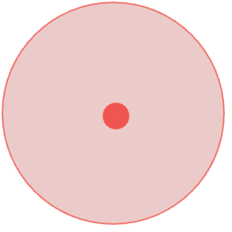


Finding the Right Technology
A Comparison of AI Approaches
Visual of Dice Score
Dice = 1.0
Dice = 0.70
Dice = 0.40
Rigorous Testing
Ground Truth
Prediction
Notes:
Our primary metric for success was the Dice Score. The idea is very simple. The Dice Score just measures the amount of overlap between the expert's annotation and our model's prediction of the oyster outline.
If they match perfectly, the Dice Score is 1. If the overlap is pretty good, you get a high score. If it's a poor match, you get a low score.
Basically, the closer the score is to 1, the better our model is at replicating the expert's work.
[Click to hide the overlay and return to the main table]

Slide 12

Finding the Right Technology
A Comparison of AI Approaches
Approach | Methodology | Key Finding | Avg. Dice Score
Classical CV | Thresholding & Watershed | Brittle & Parameter-Sensitive. Fails on complex slides and requires constant manual tuning. | 0.7463 ± 0.1287
U-Net | Supervised Deep Learning | Data Starved. The model was limited by the small dataset, leading to poor generalization. | 0.3801 ± 0.1104
SAM | Promptable Foundation Model | Most Robust & Data-Efficient. Intelligently handles fragmentation and leverages pre-trained knowledge. | 0.8846 ±0.0600
Notes:
So, with that in mind, here are the detailed results from our investigation.
This table shows the performance of each method, but to make the key takeaway easier to see, let's visualize this as a simple bar chart.
[Click to show Bar Chart]

Slide 13
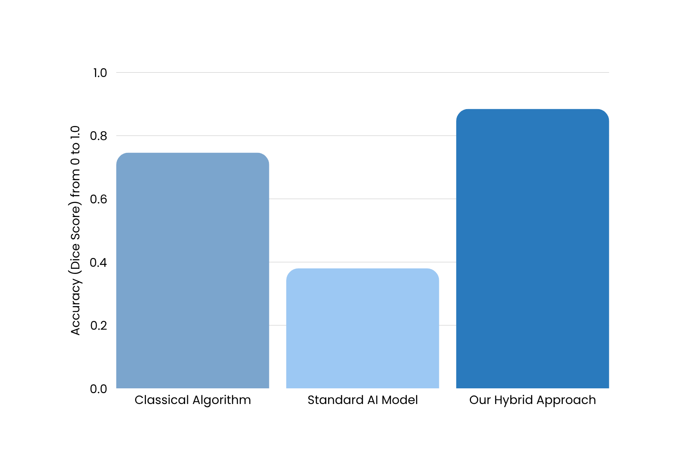
Finding the Right Technology
A Comparison of AI Approaches
0.88
0.75
0.38
Notes:
This chart makes the story clear.
The Classical Algorithm gave us a decent start, but its accuracy, around .75, wasn't high enough to be reliable.
The Standard AI Model completely failed. We likely didn’t have enough data, resulting in a very low accuracy. This proved that an off-the-shelf approach wouldn't work.
But Our Hybrid Approach was a massive improvement, achieving an accuracy score of nearly .9. It proved to be the most robust and data-efficient method by a wide margin.
This gave us complete confidence that we had found the right technology for the job. So, let me briefly show you how this winning approach works.
[Click to next slide]

Slide 14

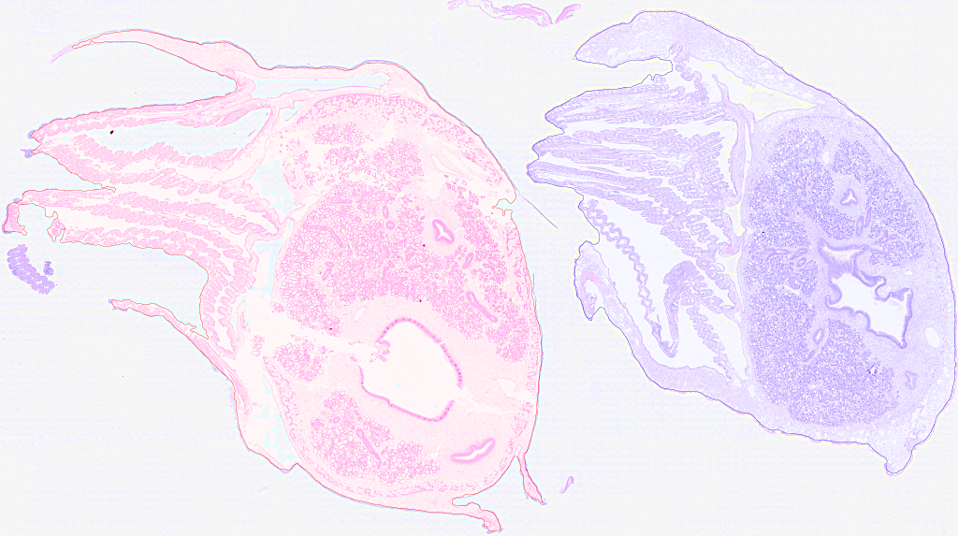
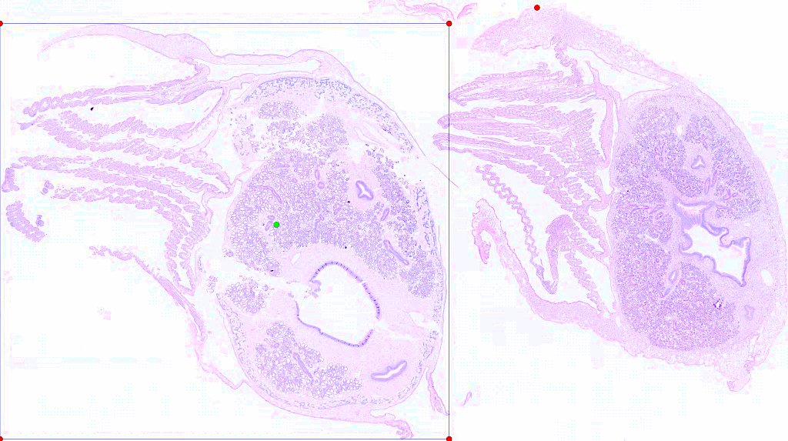
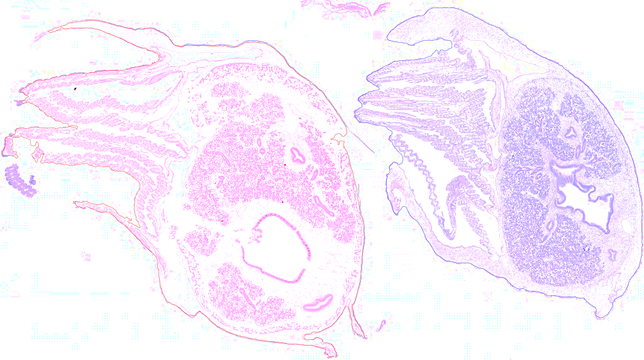

The Solution
This hybrid strategy uses a simple, reliable method to answer 'where,' and the powerful foundation model to answer 'what.'
A Hybrid Pipeline for Intelligent Prompting
Step 1: Generate Robust Prompts (CV)
Step 2: Precise Segmentation (SAM)
Notes:
[Click to show Step 1 image]
Step one answers a simple question: 'Where is the tissue?' I wrote a script that quickly scans a low-res version of the slide to find the general location of each oyster. And then it generates a set of simple instructions–or prompts– for the next step.
[Click to show Step 2 image]
Then, in step two, we pass those instructions to the powerful foundation model, SAM, to answer the much harder question: 'What is the exact boundary?'
We’re basically telling it: 'The thing I want you to find is inside this box, it includes the green dot, and it definitely doesn't include the red dots.' And because SAM has seen billions of images, it's really good at following these simple directions to produce a precise outline.

Slide 15
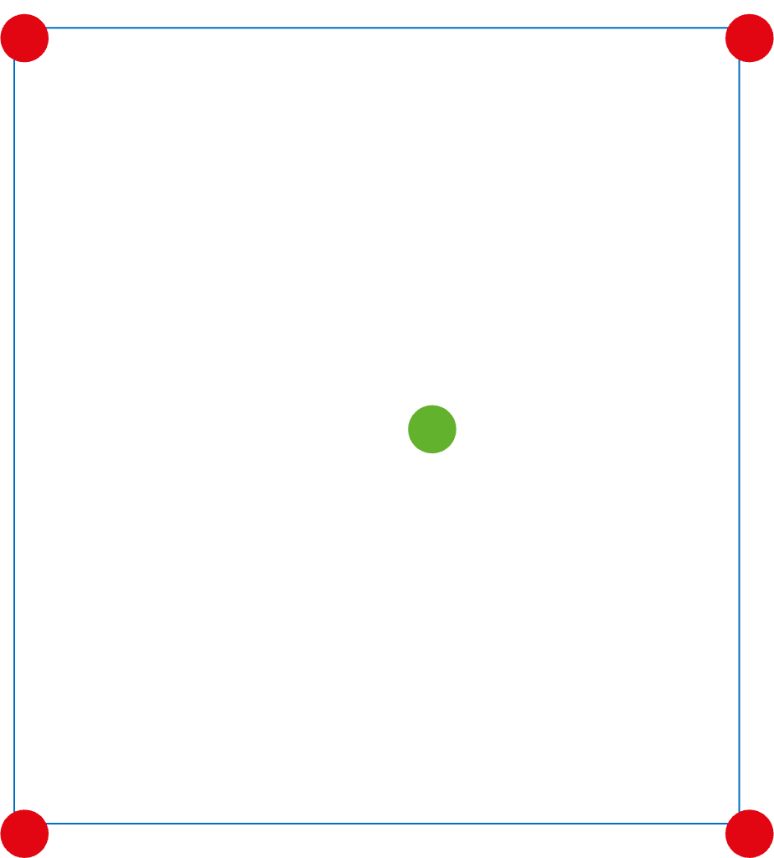
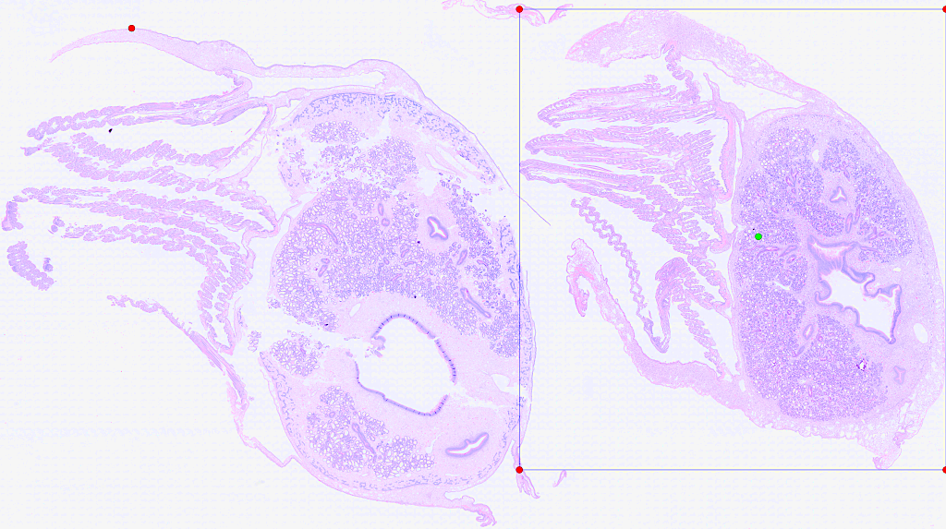
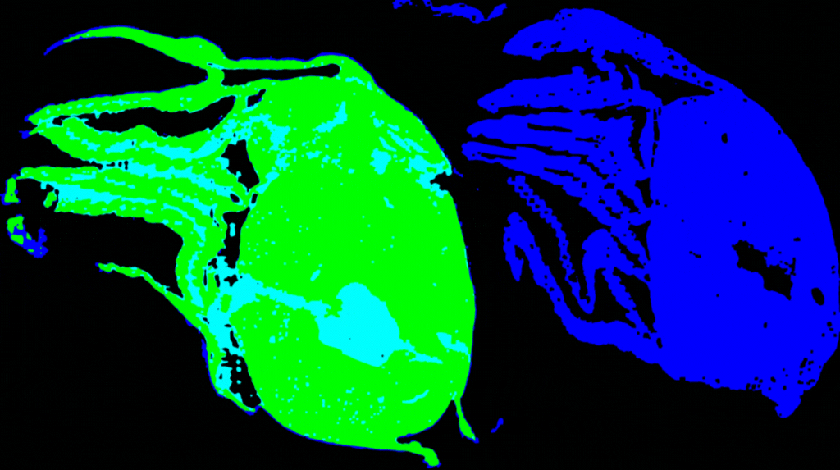
The Solution
This hybrid strategy uses a simple, reliable method to answer 'where,' and the powerful foundation model to answer 'what.'
A Hybrid Pipeline for Intelligent Prompting
SAM’s Guess
Expert Annotation
Step 1: Generate Robust Prompts (CV)
Step 2: Precise Segmentation (SAM)
Notes:
Here’s a direct comparison. In blue is the expert’s ground truth, and in green is our solution's output. We can see the overlap is excellent.
[Click to next slide]

Slide 16

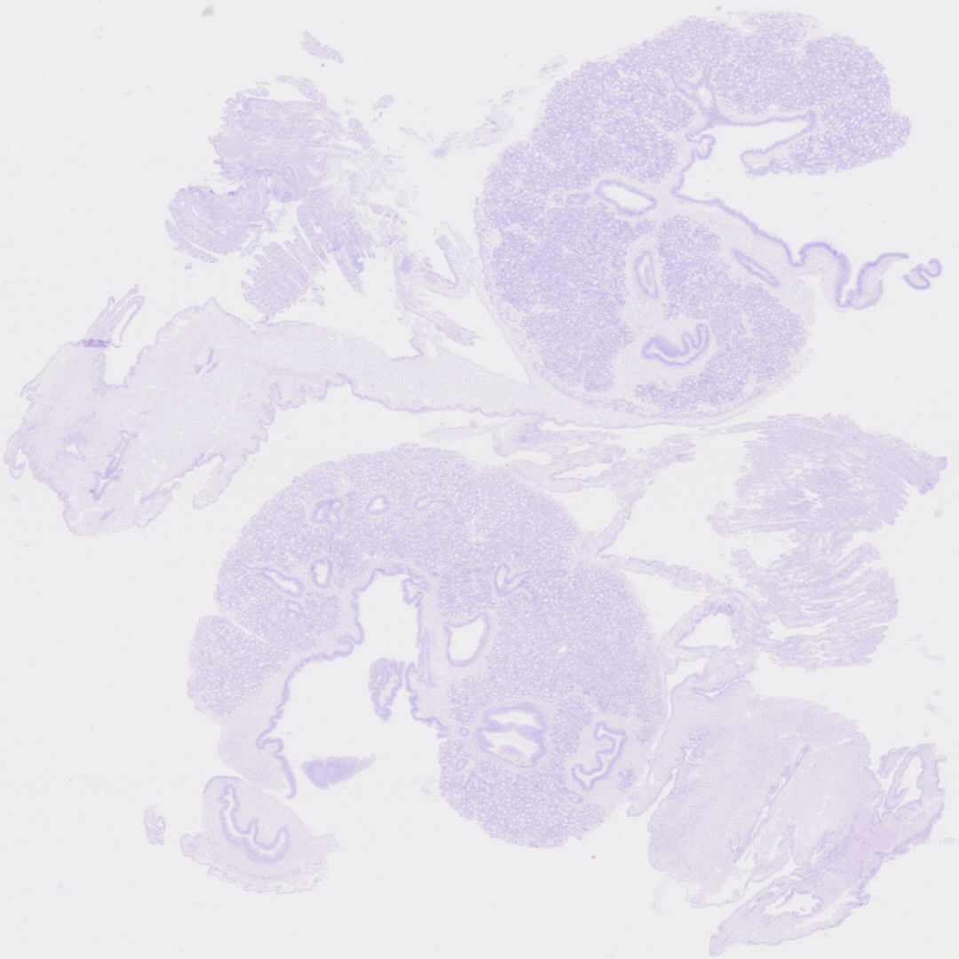

Current Limitations & Diagnosis
Brittle Prompt Generation
Small Dataset Size
30
Slides
(32,000+ Patches/slide)*
The current CV-based prompter is the weakest link and can fail on complex slides.
While 30 slides generate hundreds of thousands of training patches, they don't capture the full range of biological variability needed for a production-ready model.
These limitations are not roadblocks; they are a clear and actionable guide for what to do next.
Notes:
Our analysis gives us a very clear diagnosis of the system's two main limitations right now.
The first, and most significant, is the simple script we use for prompt generation. Let me show you what I mean.
(Gesture to the GIF)
Here you can see our classical algorithm in action on a difficult slide where the tissues are touching. It's trying to find the boundaries, but as you can see in the intermediate steps, it gets confused by the connection point and incorrectly merges both oysters into a single object.
This results in a completely wrong mask, which makes the next step of the pipeline inaccurate. This is exactly what we mean by a 'brittle' prompter, and it's the primary failure case of our system.
The second limitation is the size of our dataset. It's important to distinguish between slides and training samples—our 30 slides generate hundreds of thousands of patches for the model to learn from. However, they don't capture the full range of biological variety you'd see in the field. So to build a truly robust detector, we simply need more data.
But it's important to see these limitations for what they are. They aren't roadblocks; they're a clear guide for what to do next.

Slide 17

The Path Forward: A Phased Plan
Medium-Term
Long-Term
Phase 1:
Building the Knowledge Base
Phase 2:
Developing the Field-Ready Assistant Tool
Objective: Expand the dataset to capture the full range of biological and technical variability.
Action: Utilize the complete HIL pipeline. Use our robust SAM segmenter to pre-annotate 50-100+ new slides for rapid expert validation.
Objective: Fulfill the project's primary mission of accelerating MSX diagnosis.
Action: With the segmentation problem solved and a large dataset in place, proceed with training a high-performance YOLO-based MSX detector.
Notes:
We have a two-phase plan to take this project from a successful proof-of-concept to a production-ready tool.
And I'm happy to report that Phase 1 is already underway. Our Human-in-the-Loop pipeline is fully functional, and we are actively using it right now to build our knowledge base. We're using our robust segmenter to pre-annotate new slides, which will allow us to expand our dataset and capture the full range of biological variability we need.
Once that expanded dataset is in place, we will move to Phase 2: Developing the field-ready assistant tool. With the data challenge solved, we can then train a high-performance detector that can fulfill the project's core mission: building a validated, trusted tool to help pathologists provide faster, more accurate diagnoses.
So, to wrap up...

Slide 18
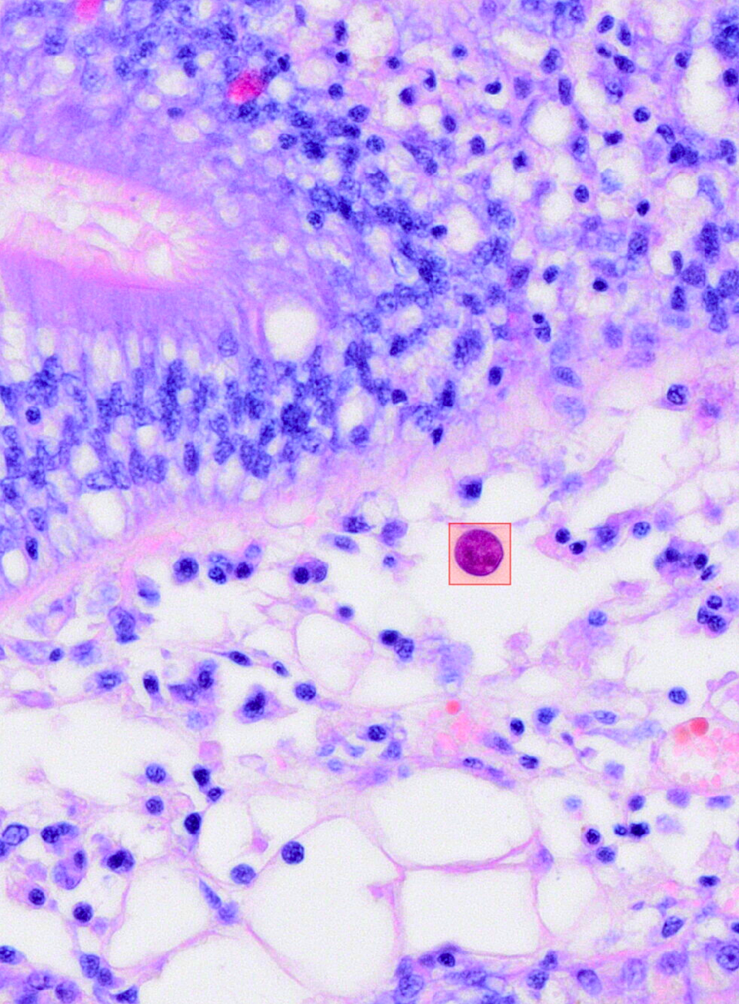
Conclusion & Takeaways
Built the Foundation for a New Tool
We've successfully engineered a working prototype of an AI-assisted system that is already being used to build our knowledge base.
Achieved High Accuracy on the First Critical Step
We've developed a reliable method to automatically find and separate oysters on a slide, paving the way for parasite detection.
Established a Clear Path to a Field-Ready Solution
We have a concrete, phased plan to turn this successful prototype into a validated tool for pathologists.
Notes:
This summer, we took this project from an idea to a fully engineered pipeline.
[Click to show Second Point]
We solved the segmentation challenge with a data-driven approach.
[Click to show First Point]
And lastly, we've turned our results into a clear plan for what comes next.
At the end of the day, this work lays the foundation for a tool that can help protect one of our region's most important industries.
Thank you. I'd be happy to answer any questions.
‹#›

Slide 19


NOVEMBER 2025
Thank
You
BY JONATHAN E. ZUL LUNA
Notes:
1.7.2013
I'd like to quickly thank my mentors, Dr. Kupferschmidt, Dr. Godbout, and Dr. Groman, for their guidance throughout this project.
I would now be happy to answer any questions you may have.
WHAT DID YOU DO TO TRY TO IMPROVE UNET?
ENCODER, FREEZING,
‹#›

